Slide 1
iOS Application Lifecycle
Mobile apps for iPhone & iPad
Telerik Software Academy
http://academy.telerik.com

Slide 2
Table of Contents
iOS app Execution model
UIApplication object
UIApplicationDelegate object
UIViewController
Lifecycle
Events
State

Slide 3
UIApplication
Execution model and lifecycle

Slide 4
Execution model – Entry Point
iOS Application main function:
#import <UIKit/UIKit.h>
#import "AppDelegate.h"
int main(int argc, char * argv[])
{
@autoreleasepool {
return UIApplicationMain(argc, argv, nil,
NSStringFromClass([AppDelegate class]));
}
}
Called in the main entry point to create the application object, delegate and set up the event cycle

Slide 5
UIApplicationDelegate
UIApplicationDelegate – protocol declares methods that are implemented by the delegate of the singleton UIApplication object.
AppDelegate – implements the application delegate to expose the control over the UIApplication

Slide 6
UIApplication: States
Application states:
Not Running – the app is not launched
Inactive – the app is running in the foreground but is currently not receiving events
Active – the app is running in the foreground but is receiving events
Background – the app is running in the background and executing code
Suspended – the app is in the background but is not executing code

Slide 7
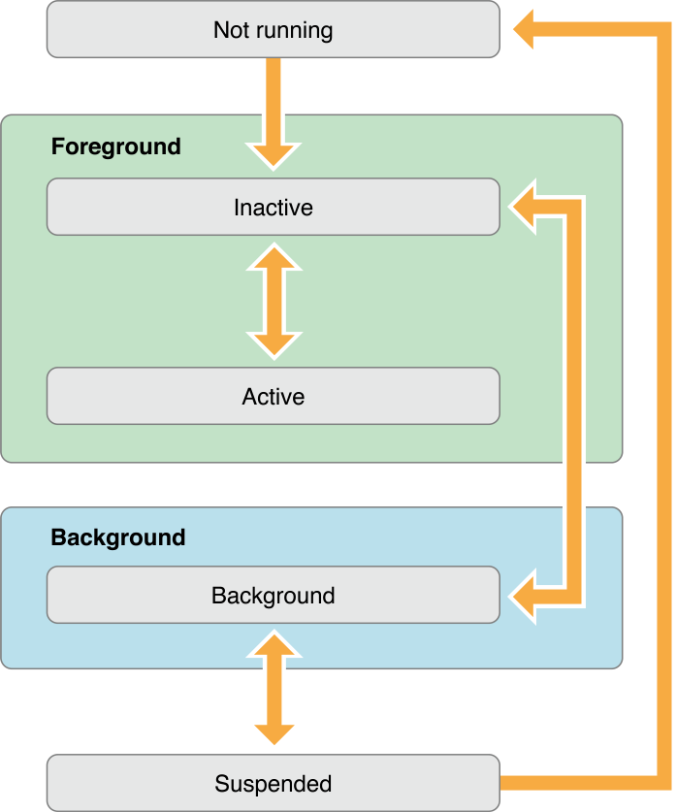
UIApplication: States (2)

Slide 8
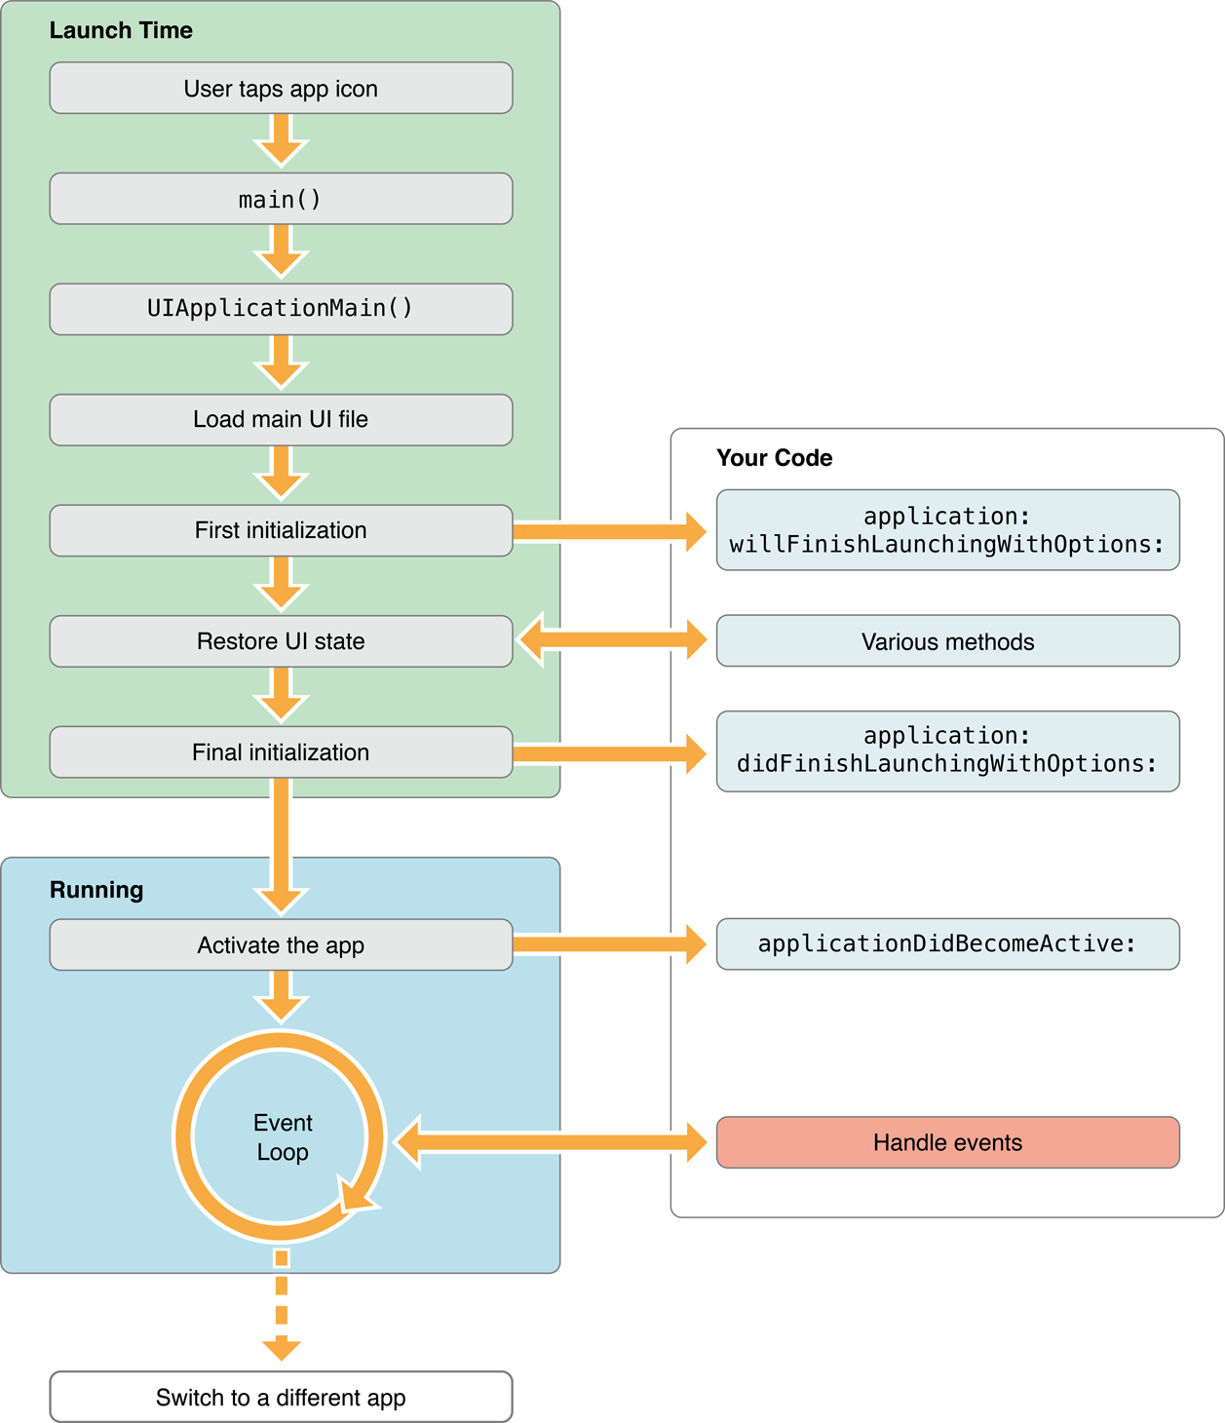
UIApplication – Launch Cycle

Slide 9
UIViewController States
Overview and usage

Slide 10
Overview: UIViewController
UIViewController:
Provides the fundamental view-management model
Coordinates its efforts with model objects and other controller objects communication
Responsible for a single view
States preservation and restoration

Slide 11
UIViewController – API (1)
Managing the View
view – the root view of the controller’s view hierarchy
viewDidLoad – it is called after the view controller has loaded its view hierarchy into memory
Handling Memory Warning
didReceiveMemoryWarning
Sent to the view controller when the app receives a memory warning

Slide 12
UIViewController – API (2)
Responding to View Events
viewWillAppear
Notifies that its view to be added to a view hierarchy
viewDidAppear
Notifies that that its view is added to a view hierarchy
viewWillDisappear
Notifies that its view is about to be removed from a view hierarchy

Slide 13
UIViewController – API (3)
viewDidDisappear
Notifies that its view is about to be removed from a view hierarchy
viewWillLayoutSubviews
Called to notify the view controller that its view is about to layout its subviews
viewDidLayoutSubviews
Called to notify the view controller that its view has just laid out its subviews

Slide 14
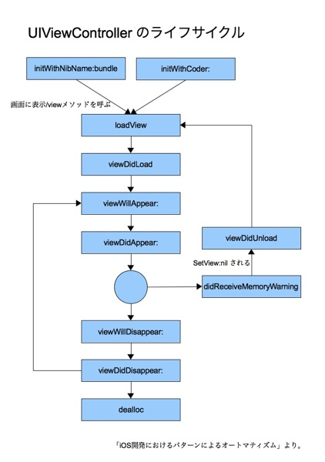
UIViewController - Lifecycle

Slide 15
iOS Application Lifecycle

